Slide 1
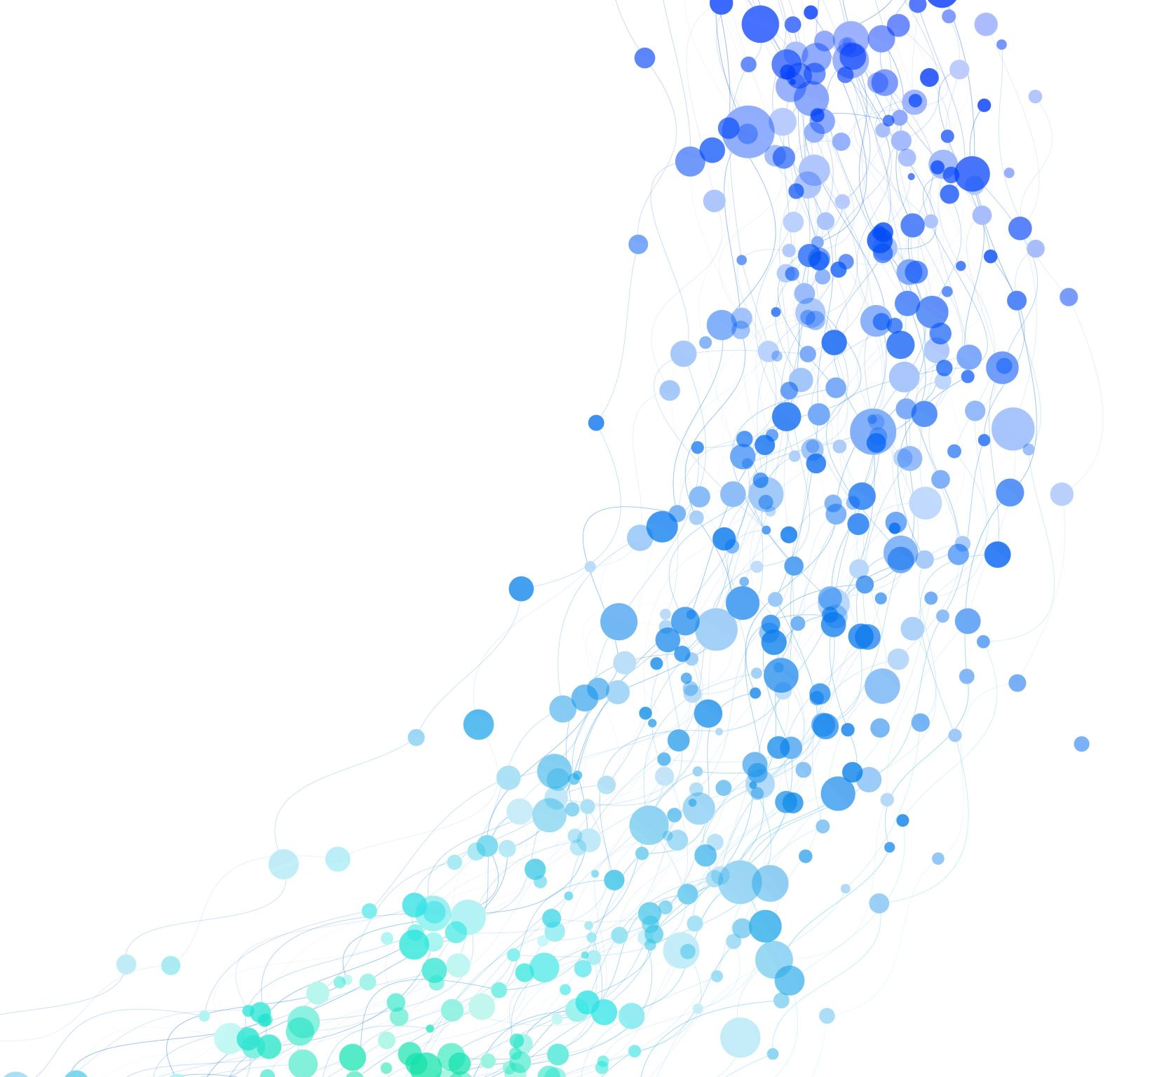
Many Body Post-Minkowski Simulation
Zackary Windham
Advisor: Dr. Neilsen

Slide 2
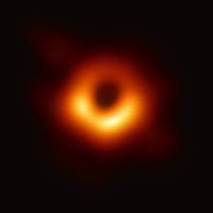
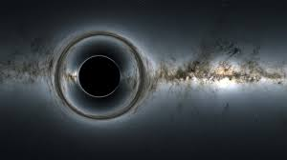
General Relativity And Black Holes
M87 Galactic Center
Credit: Nasa
Notes:
General relativity describes gravity as the curvature of space-time
It allows for some weird effects like the bending of light and time.
Black hole are predicted by the equations of general relativity; the image on the right is an imaged black hole.

Slide 3
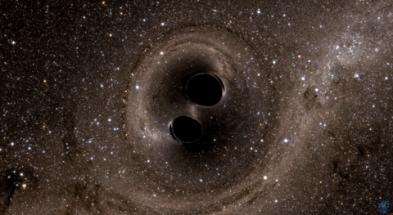
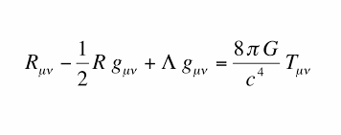
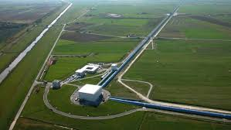
Gravitational Waves
Credit: NASA
ligo.caltech.com
Notes:
Large objects moving through space-time produce gravitational waves; ripples in space-time.
Because we can’t really detect black holes with light like we can with stars, gravitational waves are a to observe black holes and study them from the information these waves give us.
LIGO was built to detect gravitational waves; however, it needs to know what it’s looking for.
We can use the equations of GR to simulate what a black hole binary merger would look like and thus to predict what the gravitational waveform would look like.
However there are millions of different potential merger scenarios, that all have different waveforms. So LIGO needs an archive of templates to which it can match what it detects and see if it fits any theoretical gravitational waveforms.
More slides here; roughly one slide per minute.
Mention later detections of gravitational waves as well; include stellar graveyard graphic.
Takes two months to run a code at the production level needed to analyze GW.
Motivate having a template library more.

Slide 4
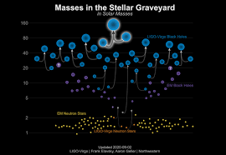
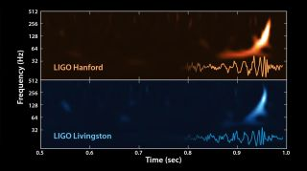
Black Hole Observatory
https://www.space.com/31894-gravitational-waves-ligo-search-complete-coverage.html
https://www.ligo.caltech.edu/image/ligo20200902a
Notes:
The first gravitational waves were detected back in 2015; their waveform is shown here.
It was a merger of two black holes
Since then, LIGO has observed many different mergers of stellar remnants that we’ve been able to study. Shown is a diagram of masses in the stellar graveyard, which is called that due to the fact that the neutron stars and black hole merging are remnants of dead stars. Most of the objects in this diagram were detecting using gravitational wave observation since 2015.

Slide 5
Full GR Equations
Evolution Equations
Coordinate Conditions
Constraint Equations
Notes:
These equations are very complicated. Some formulations can get up to 60 different variables.
Trying to solve this can take up to four days on a supercomputer just to simulate four orbits of a binary black hole merger.
In order to run a simulation with full GR equations that goes for long enough to get a gravitational waveform, it can take up to two months to run.

Slide 6
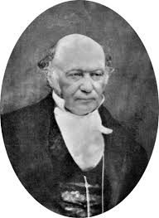
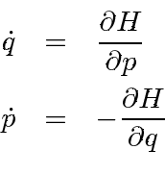
What is a Hamiltonian?
Notes:
We use a Hamiltonian equation to approximate the equations of GR. These equations were derived by Sir William Rowan Hamilton.
A Hamiltonian takes two arguments, q represents the position of an object and p represents its momentum; these are typically in vector form.
The partial derivative of a Hamiltonian with respect to position gives the negative change in momentum in time, and the partial derivative of a Hamiltonian with respect to momentum gives the change in position in time.
Using these derivatives, we can numerically solve for the paths of motion of bodies in a system.

Slide 7
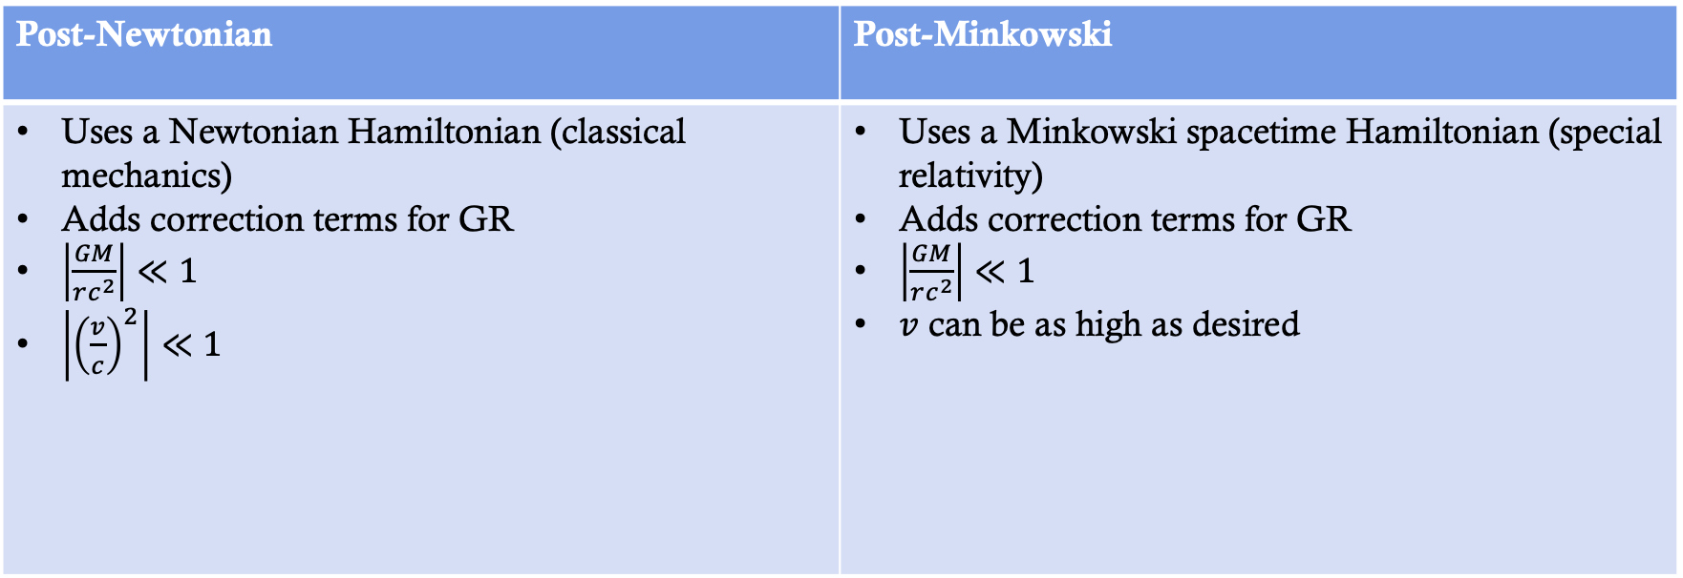
Post-Minkowski Approximation
Post-Newtonian | Post-Minkowski
Uses a Newtonian Hamiltonian (classical mechanics) Adds correction terms for GR $\left|\frac{GM}{rc^{2}}\right|≪1$ $\left|{\left(\frac{v}{c}\right)}^{2}\right|≪1$ | Uses a Minkowski spacetime Hamiltonian (special relativity) Adds correction terms for GR $\left|\frac{GM}{rc^{2}}\right|≪1$ $v$ can be as high as desired
Notes:
The Post-Newtonian is most popular and has been worked on the longest. This takes a Hamiltonian for classical Newtonian gravity and adds general relativistic correction terms.
Approximates the full equations of general relativity.
Too many words. They won’t listen to what you’re saying.
Do a compare/contrast between PN and PM.
Talk about what a Hamiltonian as, add another slide after this.

Slide 8
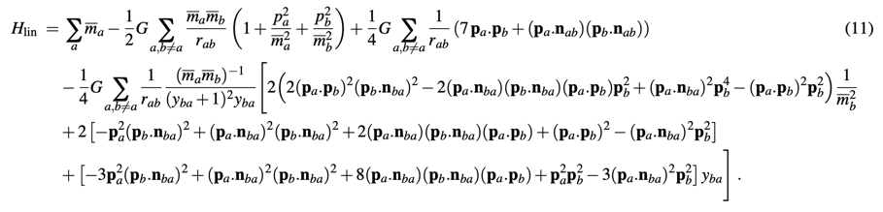
Post-Minkowski N-body Equation to First Order in G
We have written a code to solve this in equation in Julia, using their suite of advanced ODE solvers.
Notes:
PM is to second order for two-body, just n-body is only to 1st order. PN has just been worked on for longer.

Slide 9
Mystery Black Holes
Notes:
Returning to this image of the stellar graveyard, the simplest way for a black hole binary to occur is if the two black holes formed in situ, essentially so that they both formed near each other and orbit each other until merger. We know binary star systems are very common, so this is a way for them to merge that we understand.
However, some of these detected black holes are too massive to have been formed from dying stars.
Many of these systems may have formed in more complex ways such as dynamical capture of passing black holes.
Using our Post-Minkowski code, we can simulate these more complex systems and find out what kinds of systems could result in the gravitational capture of a black hole or potentially just catapult something back out of the system.

Slide 10
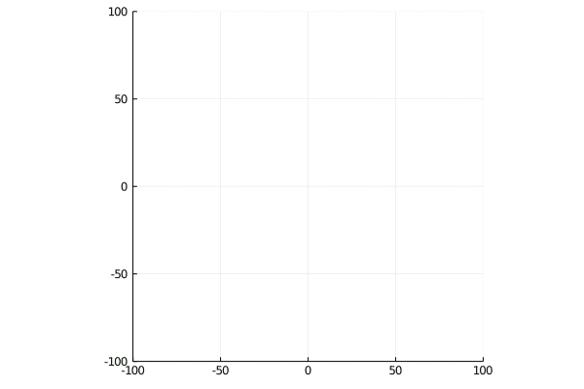

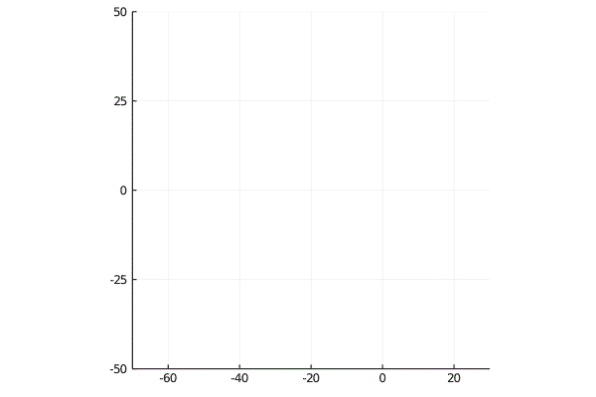
Examples
Notes:
These are some examples produced by our code of dynamical situations where something like a massive black hole could form. The code is currently only capable of simulating up to a five-body system, so each of these has five bodies. Note that in the image on the left, two of the bodies are thrown out.
Mention that the first two have very similar initial conditions.
Talk about how these are dynamical situations where these massive black holes could form.

Slide 11
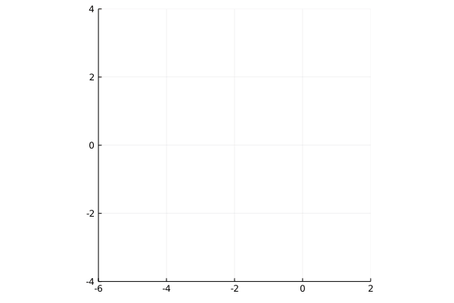

Problem of Initial Conditions
Correct initial conditions will produce a circular orbit. The example shown here is the animation of the orbital paths of two bodies with a mass ratio of 2.
What it should look like
What the code is producing
Notes:
This is just a test to make sure the code is accurate; not all that interesting as a result.
Could be numerical error; we do convergence tests and increase step size of the solver to check this.
Could be that the code doesn’t match the equation in the paper; we’ve quadruple checked this.
Could be we don’t have the correct way to calculate initial conditions; we’ve found four separate ways to calculate initial conditions for a binary PM system to first order that all agree.
Could be that the equations in the paper are wrong; we’re in the process of checking that now.
Concisely talk about each possible explanation and how we would check it.

Slide 12
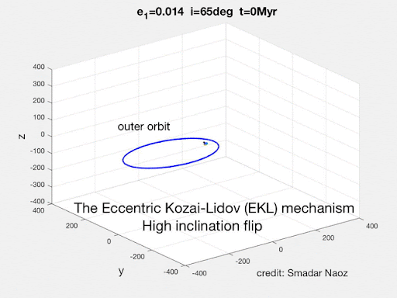
Kozai-Lidov Mechanism
Notes:
We will convert this to a pure N-body code and move it to C++ so it can run faster
We will add the capability to detect collisions so that we can know if there’s a merger.
We will create a large system of a star cluster of potentially 100s of stars and run it with random initial conditions to see what’s produced.
We’ll compare this with the Post-Newtonian case. We hope that PM makes things more unstable so that it’s easier to have collisions and mergers, which can help us better explain the extremely large black holes .
Note that we’ll be comparing with Newtonian case; hopefully, PM makes things more unstable so that it’s easier to have collisions.

Slide 13
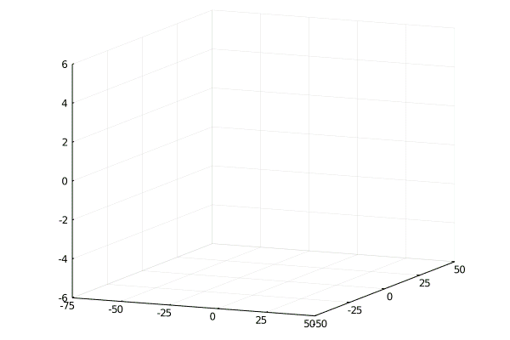
Conclusion
Gravitational waves are an important method of observing black holes.
In order to find gravitational waveforms, we need approximations.
Large black holes have been detected that could have been formed by dynamical capture.
We will use a GR approximation in a code to simulate large systems and see if large black holes form.
Notes:
Make a bullet list of three or four most important points.

